Slide 1
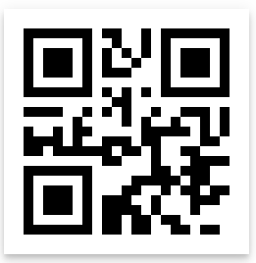
SMART QR
TEAM 1:
Murali Krishna Sai Chukka & 05
Venkatesh Ponduri & 23
Apoorva Geetanjali Avadhanula & 01
Hima Bindu Vatsavayi & 28

Slide 2
What is SMART QR ?

Slide 3
Where else we can use SMART QR ?
Sharing the Website links.
E.g.: In class, we are providing reference link for any ICP’s or Lab’s.
Sharing some limited information like mobile number, email etc.,

Slide 4
Modules (Not yet confirm)
Login & Registration with Firebase.
Create Smart QR Card.
Scan QR.
User profile.
Scan Visiting card.
Update Card details.

Slide 5
Technologies Used
Ionic 3.
Firebase.
OCR (Optical Character Reader).
Tesseract Ionic Library.
IBM Watson.
Google Vision API.
Ionic SQLite to Interact with Mobile Database.

Slide 6
Questions ?

Slide 7
Thank you..☺

